Slide 1
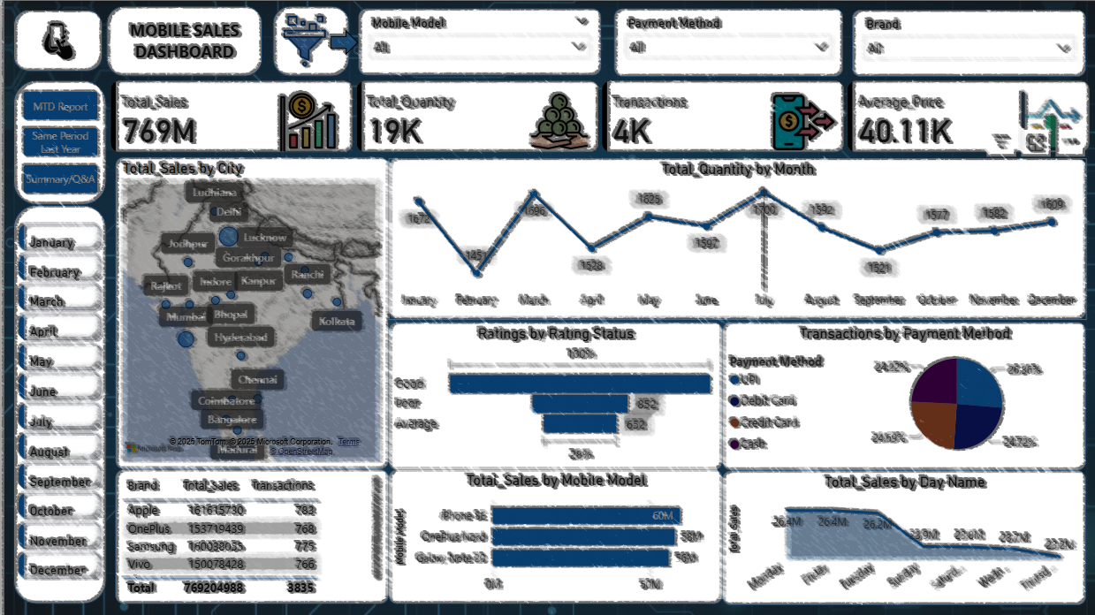
Mobile Sales Dashboard – Power BI
- Melvin Sujay

Slide 2
Introduction
Business Problem / Objective:
To provide a clear and interactive dashboard for tracking sales, quantity, and performance trends across different time periods.
To identify top-performing mobile models, cities, brands, and preferred payment methods.
To support data-driven decision-making through visual analytics.
Business Challenges:
Lack of visibility into sales performance across different time periods
Difficulty in identifying top-performing products and underperforming models
Need to understand customer payment preferences and regional sales patterns
Requirement to track sales trends and compare year-over-year performance
Need to analyze customer satisfaction levels and their impact on business

Slide 3
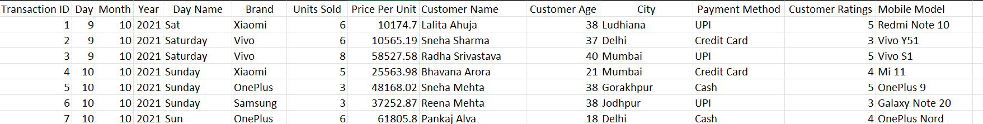
Data Preparation in Power BI
Imported Excel sheet into Power BI and accessed 'Transform Data' to clean and shape data.
Merged Day, Month, and Year columns into a single 'Date' column and set data type to Date.
Removed invalid Day Name column entries and redundant columns to ensure data consistency.
Renamed cleaned dataset to 'Sales_Data’.
Data set data period: 2021 - 2024 (4 years, 1461 days)

Slide 4
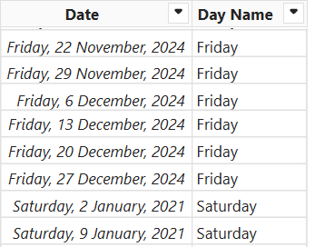
Custom Calendar Creation
Created a custom calendar table using Power Query M language:
= List.Dates(#date(2021,1,1), 1461, #duration(1,0,0,0))
Added a day name column for reference and renamed it to 'Custom_Calendar'.
This enables time intelligence functions like MTD, QTD, and YTD.

Slide 5
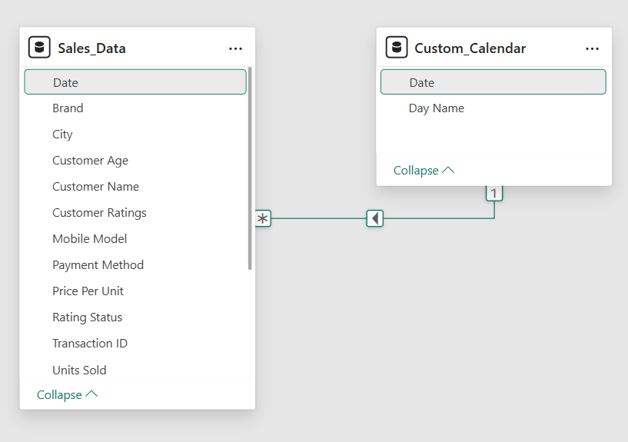
Data Modeling
Designed a star schema data model with 'Sales_Data' as the Fact table and 'Custom_Calendar' as the Dimension table.
Created a one-to-many relationship between 'Custom_Calendar[Date]' and 'Sales_Data[Date]'.
This setup allows accurate time-based aggregations and dynamic filtering.

Slide 6
KPI’s Requirement
We need to analyze key indicators for our mobile sales data to gain insights into our business performance.
1. Total Sales (Revenue)
Total_Sales = SUMX(Sales_Data, Sales_Data[Units Sold] * Sales_Data[Price Per Unit])
2. Total Quantity Sold
Total_Quantity = SUM(Sales_Data[Units Sold])
3. Total Transactions
The total number of sales orders/transactions placed by customers.
Transactions = COUNTROWS(Sales_Data)
4. Average Price Per Unit
Average_Price = AVERAGE(Sales_Data[Price Per Unit])
5. Month-to-Date Sales (MTD)
Cumulative sales from the beginning of the current month to the present date, enabling real-time performance tracking.
MTD = TOTALMTD([Total_Sales], Custom_Calendar[Date].[Date])
6. Same Period Last Year (SPLY)
Sales from the equivalent period in the previous year, enabling year-over-year comparison.
Same Period Last Year = CALCULATE([Total_Sales], SAMEPERIODLASTYEAR(Custom_Calendar[Date]))

Slide 7
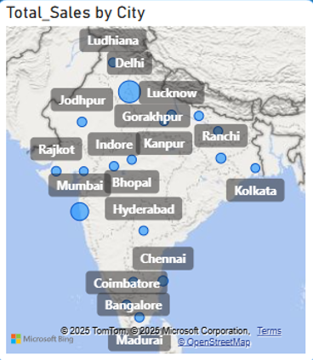
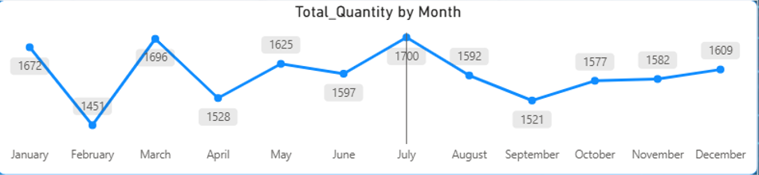
Charts Requirement
1. Geographic Sales Distribution
Chart Type: Filled Map with Bubble Size
Purpose: Display total sales across different cities in India
Fields: Location: City , Bubble Size: Total_Sales
Insight: Identifies high-performing and underperforming geographic markets, helps in regional marketing strategy and inventory distribution decisions.
2. Monthly Quantity Trend Analysis
Chart Type: Line Chart
Purpose: Track the trend of total quantity sold month-over-month throughout the year
Fields: X-axis: Date (Month from Custom_Calendar), Y-axis: Total_Quantity
Insight: Reveals seasonal patterns, peak sales months, and inventory planning opportunities. Shows whether sales volume is growing or declining over time.

Slide 8
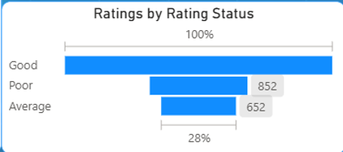
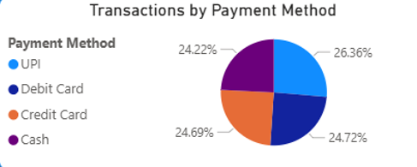
3. Customer Satisfaction by Rating Status
Chart Type: Funnel Chart
Purpose: Show distribution of customer ratings categorized as Good (≥4), Average (>2 and <4), and Poor (≤2)
Fields: Category: Rating_Status, Values: Count of Customer Ratings
Calculated Column:
Rating_Status = IF(Sales_Data[Customer Ratings]>=4, "Good",
IF(Sales_Data[Customer Ratings]>2, "Average", "Poor"))
Insight: Measures customer satisfaction levels and identifies areas for service improvement. High percentage of "Poor" ratings signals quality or service issues.
4. Payment Method Preference Distribution
Chart Type: Pie Chart
Purpose: Show percentage distribution of transactions across different payment methods
Fields: Legend: Payment Method, Values: Transactions (displayed as percentages)
Insight: Understands customer payment preferences (UPI, Debit Card, Credit Card, Cash), helps optimize payment gateway partnerships and promotional strategies.

Slide 9
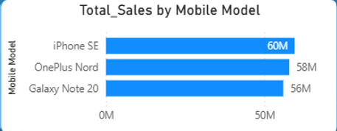
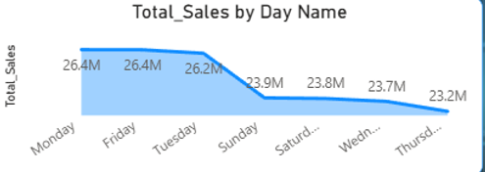
5. Top 3 Mobile Models by Revenue
Chart Type: Horizontal Clustered Bar Chart
Purpose: Highlight the best-selling mobile models based on total sales revenue
Fields: Y-axis: Mobile Model, X-axis: Total_Sales, Filter: Top 3 by Total_Sales
Insight: Identifies star products that drive maximum revenue, guides inventory stocking decisions and promotional focus.
6. Weekly Sales Pattern Analysis
Chart Type: Area Chart
Purpose: Display sales performance across different days of the week
Fields: X-axis: Day Name (from Custom_Calendar), Y-axis: Total_Sales
Insight: Reveals which days of the week generate the most sales, helps optimize staffing, promotions, and marketing campaigns timing.

Slide 10
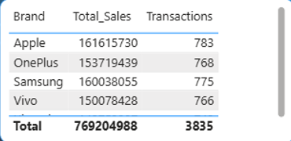
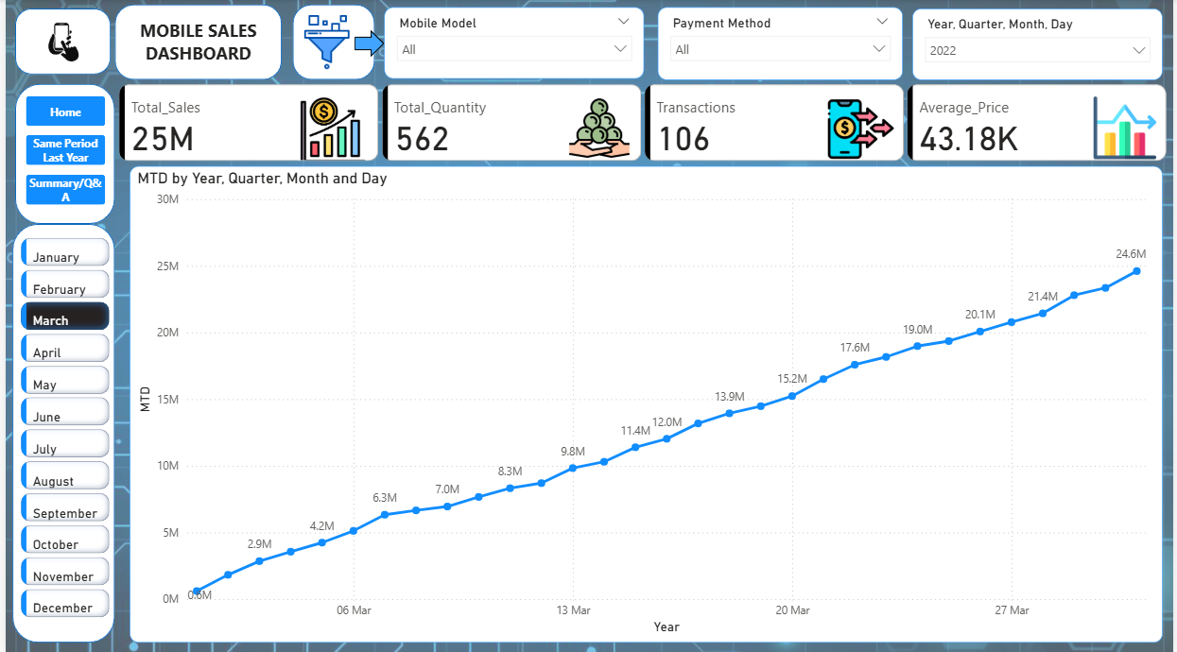
7. Brand Performance Summary
Chart Type: Table
Purpose: Provide detailed breakdown of sales and transaction metrics by brand
Fields: Columns: Brand, Total_Sales, Transactions
Insight: Compares performance across different mobile brands (Apple, Samsung, OnePlus, Vivo), identifies which brands are most popular with customers.
8. Month-to-Date Cumulative Trend
Chart Type: Line Chart
Purpose: Show progressive accumulation of sales throughout the selected month/quarter/year
Fields: X-axis: Date (from Custom_Calendar), Y-axis: MTD measure, Additional: Total_Sales for comparison
Insight: Tracks real-time performance against targets, enables quick identification if sales are falling behind projections.

Slide 11
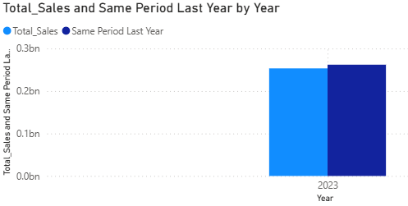
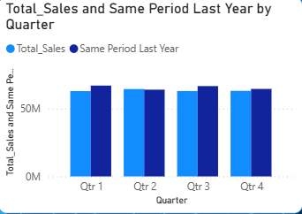
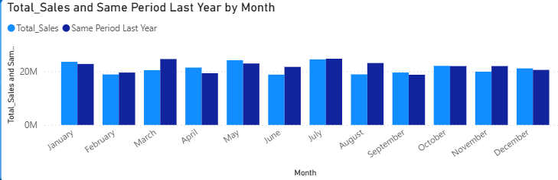
9. Year-over-Year Comparison - Annual View
Chart Type: Clustered Column Chart
Purpose: Compare current year sales with same period last year by year
Fields: X-axis: Year, Y-axis: Total_Sales and Same Period Last Year
Insight: Measures business growth year-over-year, identifies if the business is expanding or contracting.
10. Year-over-Year Comparison - Quarterly View
Chart Type: Clustered Column Chart
Purpose: Compare current year sales with same period last year by quarter
Fields: X-axis: Quarter, Y-axis: Total_Sales and Same Period Last Year
Insight: Identifies which quarters show improvement or decline compared to previous year, helps understand seasonal business cycles.
11. Year-over-Year Comparison - Monthly View
Chart Type: Clustered Column Chart
Purpose: Compare current year sales with same period last year by month
Fields: X-axis: Month, Y-axis: Total_Sales and Same Period Last Year
Insight: Provides granular month-by-month comparison to identify specific months with growth opportunities or concerns.

Slide 12
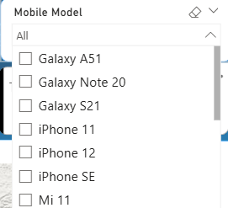
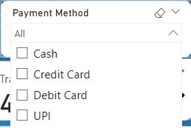
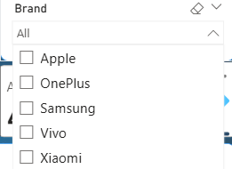
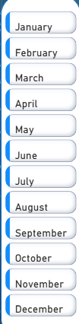
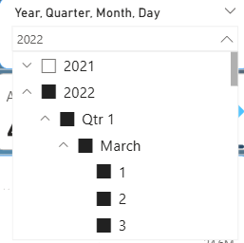
INTERACTIVE FEATURES
Filter Slicers:
Mobile Model Dropdown: Filter entire dashboard by specific phone models
Payment Method Dropdown: Analyze sales by payment type
Brand Dropdown: Focus on specific brand performance
Month Button Slicer: Navigate through different months with button-style interface
Year/Quarter/Month/Day Slicer: Drill down to specific time periods in MTD and SPLY reports

Slide 13
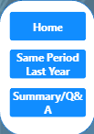
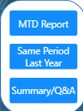
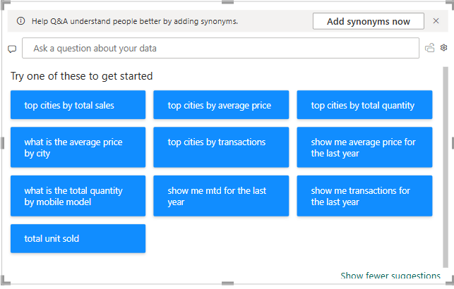
2. Page Navigation:
Home Dashboard: Main overview with all key metrics and visuals
MTD Report: Month-to-date performance tracking
Same Period Last Year: Year-over-year comparison analysis
Summary/Q&A: Natural language query interface for ad-hoc analysis
3. Q&A Natural Language Interface:
Enables users to ask questions like:
"Top cities by average price"
"What is the total sales by city“
"Show me total sales for the last year"
"Top mobile models by MTD"
- Cross-Filtering Control:
Edit Interactions configured to prevent Month slicer from affecting the Total Quantity by Month line chart. Ensures proper visual independence where needed.

Slide 14
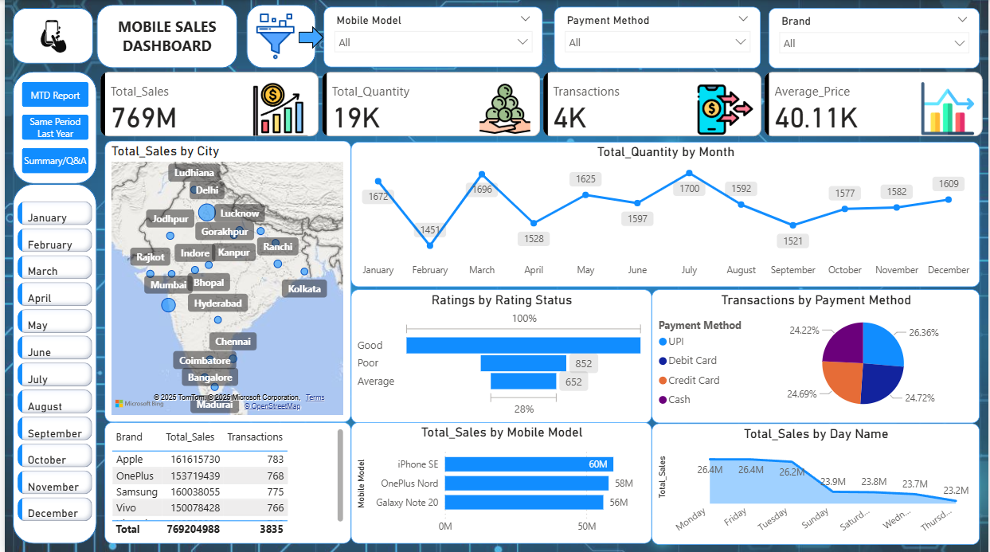
Dashboard Overview
HOME DASHBOARD:
MTD REPORT DASHBOARD:

Slide 15
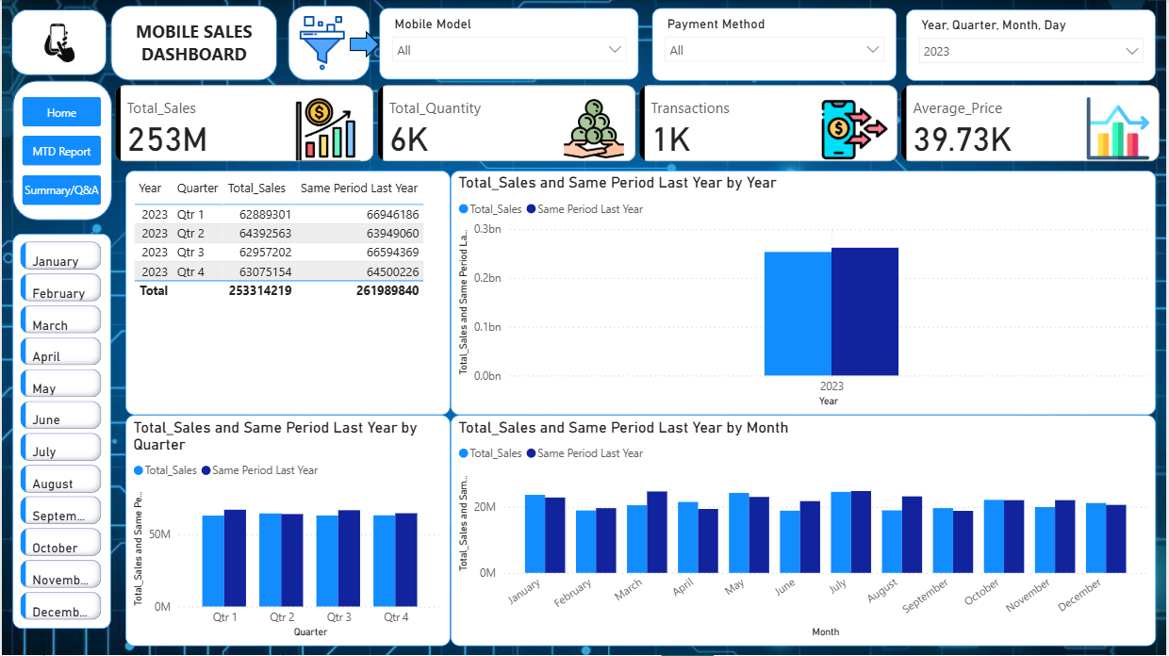
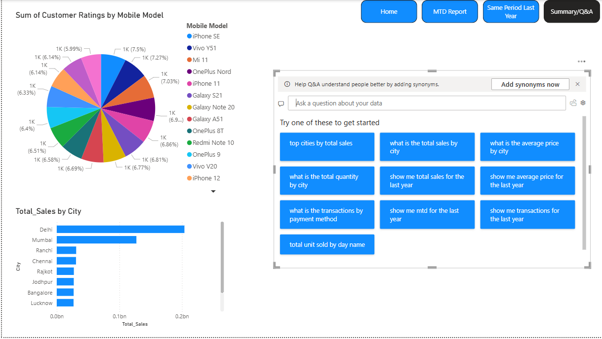
SAME PERIOD LAST YEAR:
SUMMARY / Q&A:

Slide 16
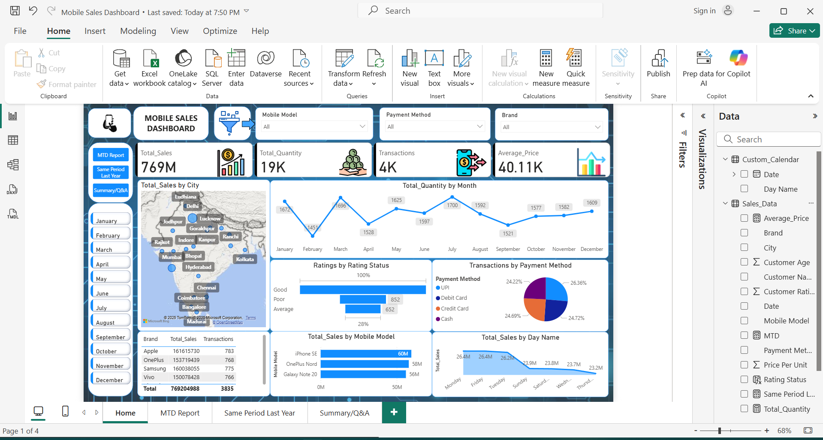
Conclusion
Built an interactive Power BI dashboard analyzing mobile sales across 4 years with 11+ visualizations including geographic maps, trend charts, and customer satisfaction funnels.
Created 8+ DAX measures for KPI tracking (MTD, SPLY) and implemented star schema data model with custom calendar table for time intelligence calculations.
Designed multi-page reporting system with dynamic filters, cross-filtering controls, and Q&A interface, enabling real-time performance monitoring and year-over-year comparison analysis.
Technologies: Power BI, DAX, Power Query, Data Modeling, ETL, Business Intelligence, Data Visualization.

Slide 17
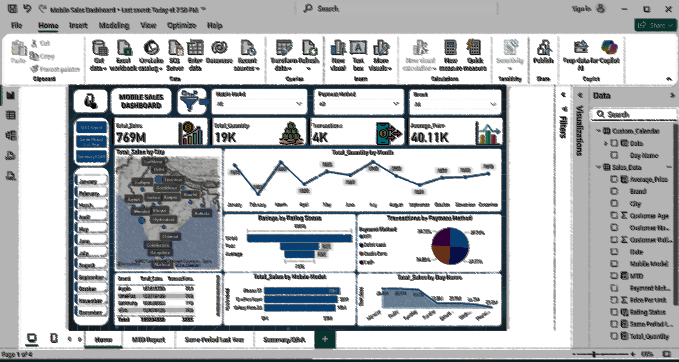
THANK YOU

